Slide 1


SAB Campus Monthly Progress – June 2025

Slide 2
Content
Academic Administrative Division
Marketing Division
Examinations Division
Finance Division
Campus Highlights

Slide 3
Academic Administration Division
 | April | May | June
Lecture Reschedules | 03 | 03 | 02
Batch Transfers | 9 | 8 | 02
 | Date | Batch | Y:S
New Semester commencement | 6/7/2025 | 16D WE/18A EX | Y3 S2
 | 6/8/2025 | 16A MOHE WD, 16B WD/WE and 15D WE | Y4 S1
 | 6/7/2025 | 1A WE (BMBA) | Y2 S2
 | 6/17/2025 | 18B WD | Y2 S1
 | 6/18/2025 | 2B WD (BMBA) | Y2 S1
End Semester | 6/1/2025 | 18B WE | Y1 S2
 | 6/1/2025 | 2B WE (BMBA) | Y1 S2
 | 6/13/2025 | 17B MOHE /WD | Y2 S2
 | 6/13/2025 | 18A WD | Y2 S1
 | 6/25/2025 | 19A WD/ MOHE WD | Y1 S1
 | 6/25/2025 | 3A WD/ MOHE WD (BMBA) | Y1 S1

Slide 4
Marketing division
 | Target | Feb/ March | July | Cumulative (July) | Sep/ Oct | Total
Applied Accounting | Budget | 100 | 150 | 250 | 50 | 300
 | Actual | 102 | 123 | 225 |  | 225
Business Analytic | Budget | 50 |  |  |  | 50
 | Actual | 21 | 27 | 48 |  | 48
Exemptions | Budget |  | 50 | 50 |  | 50
 | Actual |  | 11 | 11 |  | 11
MoHE (Applied Accounting) | Budget | 160 | 100 | 260 |  | 260
 | Actual | 102 | 126 | 228 |  | 228
MoHE (Business Analytics) | Budget | 40 | 50 | 90 |  | 90
 | Actual | 48 | 66 | 114 |  | 48
TOTAL | Budget | 350 | 350 | 650 | 50 | 750
 | Actual | 273 | 353 | 626 |  | 626

Slide 5
Examination Division

Slide 6
Status – Intake 14
Description | Student Count | %
Completed (with 14C) | 211 | 64.3
In-Progress | 75 | 22.9
Confirmed Dropouts | 42 | 12.8
Total Student Count | 328 | 100

Slide 7
Intake 15
Category | Count
2024 Convocation | 37
2025 Convocation Expected(Sp) | 146
2025 Convocation Expected(Gen) | 73
Inactive / Dropped | 45
Active / In Progress | 63
Total | 364

Slide 8
Intake 16
Summary – Intake 16
Category | Count | %
2024 Convocation | 52 | 10.5
Active | 349 | 70.8
Inactive | 78 | 15.8
Dropped | 14 | 2.8
Total | 493 | 100

Slide 9
Intake 17
Summary – Intake 17
Category | Count | %
Active | 294 | 84.2
Inactive | 20 | 5.7
Dropped | 35 | 10.0
Total | 349 | 100

Slide 10
Intake 18
Summary – Intake 18
Category | Count | %
Active | 350 | 82.4
Inactive | 56 | 13.2
Dropped | 19 | 4.5
Total | 425 | 100

Slide 11

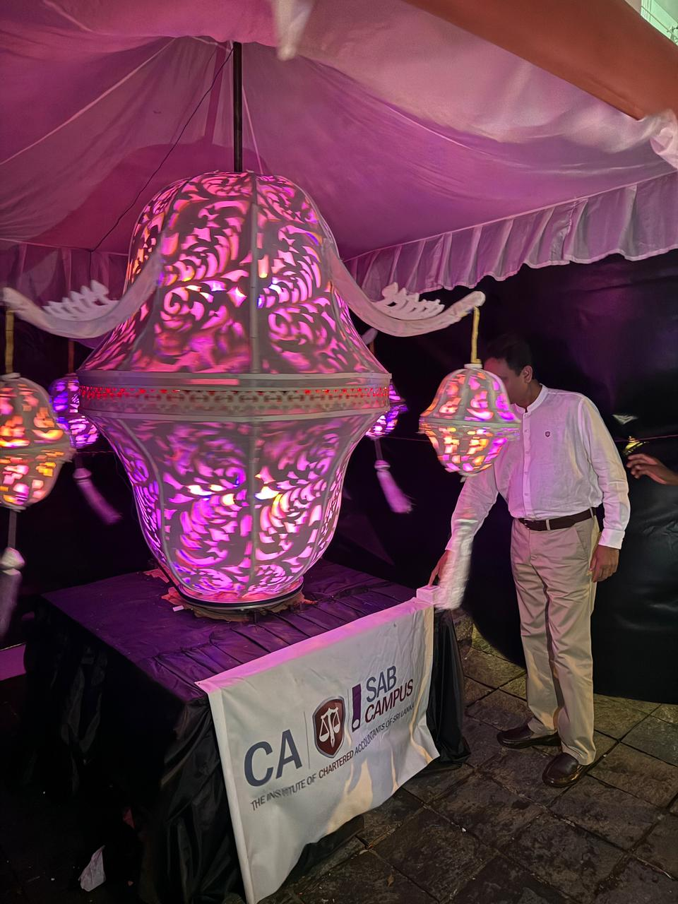
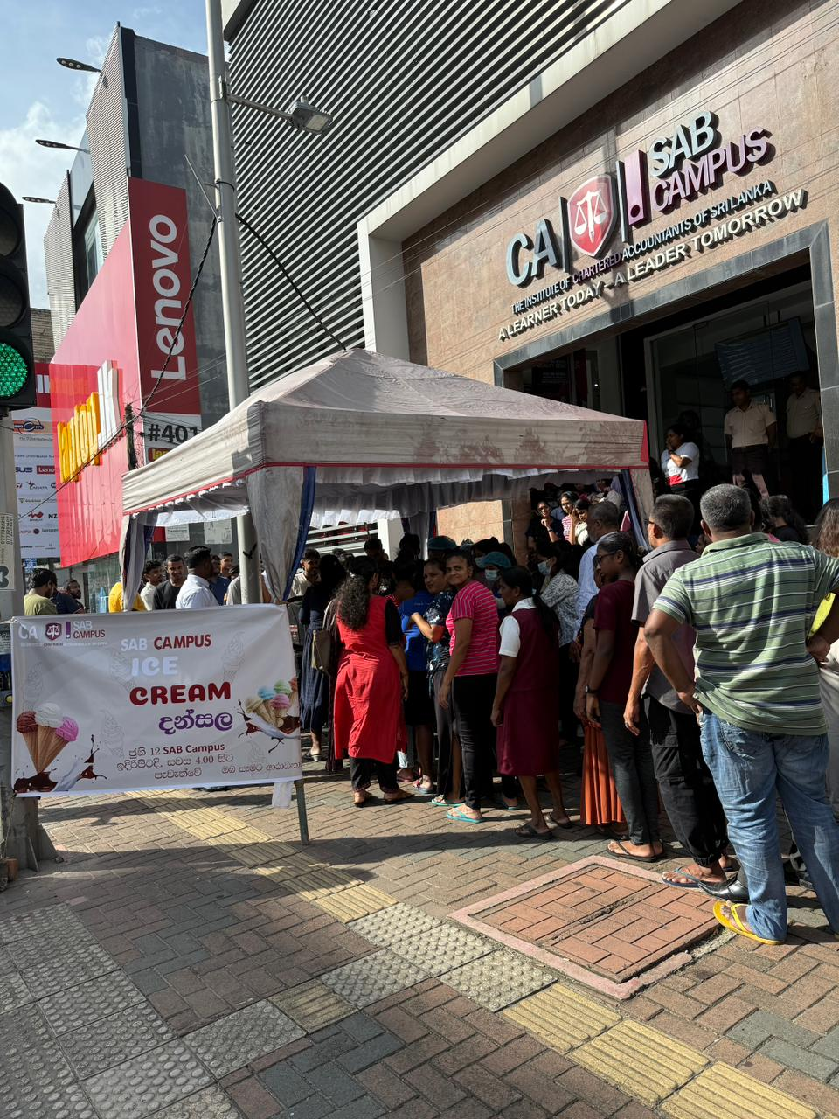
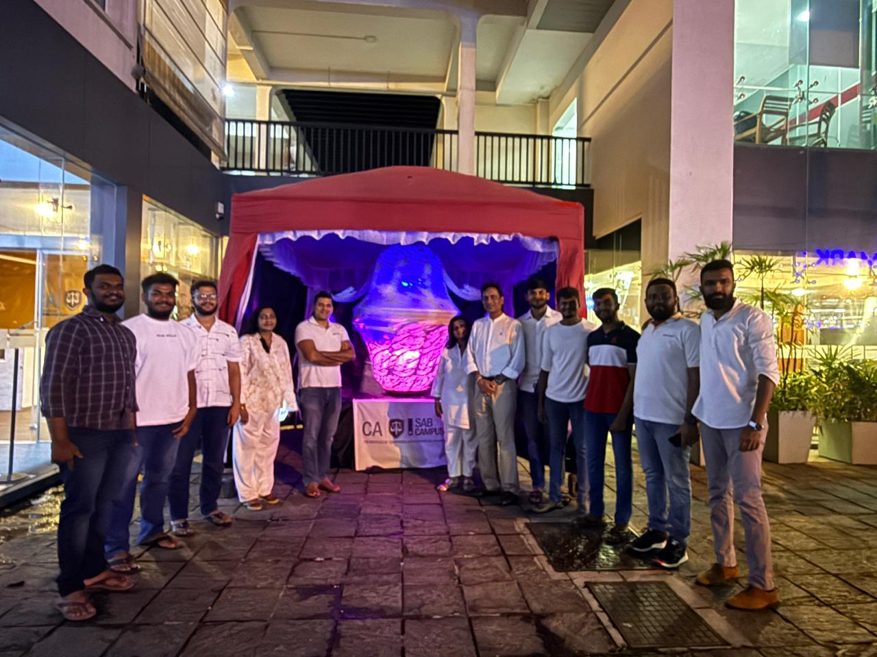
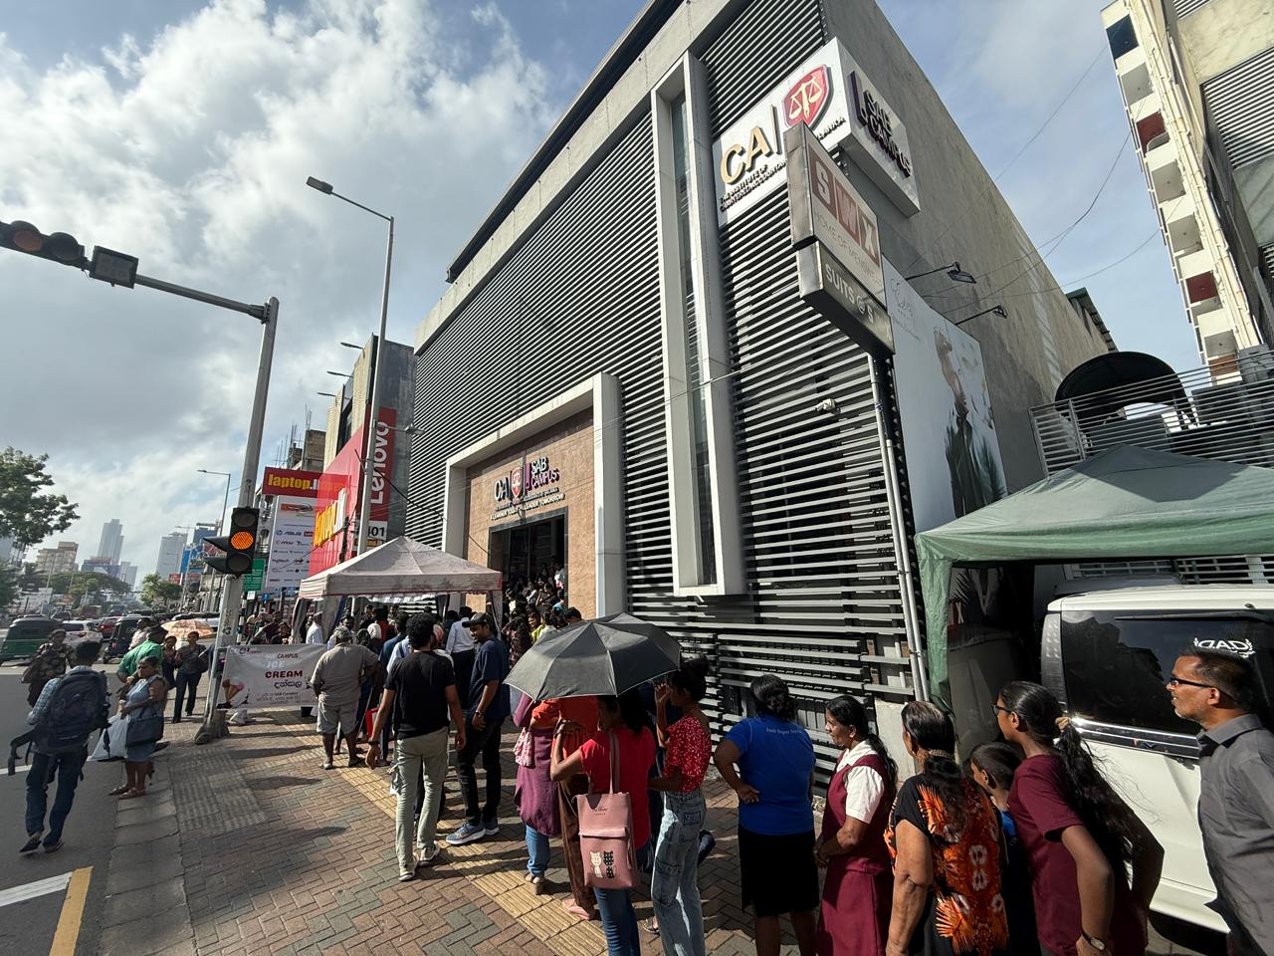
Campus Highlights
Rotating Poson Lantern- 10th June 2025
SAB Poson Dansela-12th June 2025
27th July 2025
SAB Cricket Fiesta 2025

Slide 12


